Slide 1

ETHERNET
WIRETAP
Lakshay Verma
2K20CSUN05011
BTech CSE CSTI 7

Slide 2
Contents
1
Objective
4
Procedure
Clearly state the purpose and aim of the project. What are the expected outcomes or benefits of the project?
Describe the step-by-step process followed to execute the project.
2
Goals
5
Conclusion
Outline the specific goals and targets that the project aims to achieve.
Summarise the overall outcomes of the project.
3
Project Requirements
List the requirements that are necessary for the successful completion of the project.

Slide 3
INTRODUCTION

Slide 4
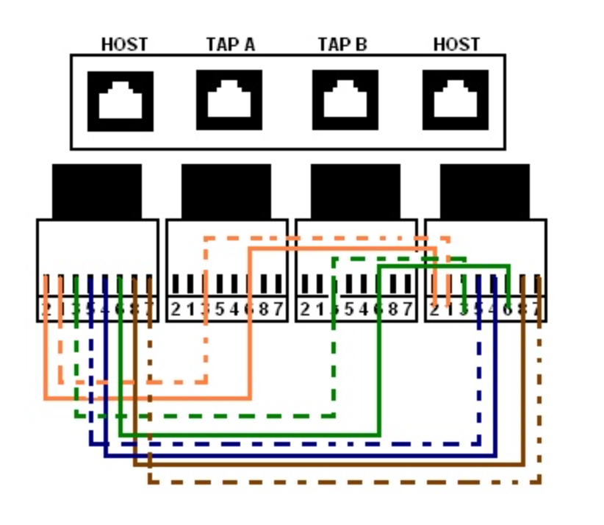
Objective
The objective of this project is to create an Ethernet Wiretap that can be installed between two switches or between a switch and a router to intercept data packets passing through them.
The wiretap can also be used to create a .pcap file of the captured data and send it to a command and control server.

Slide 5
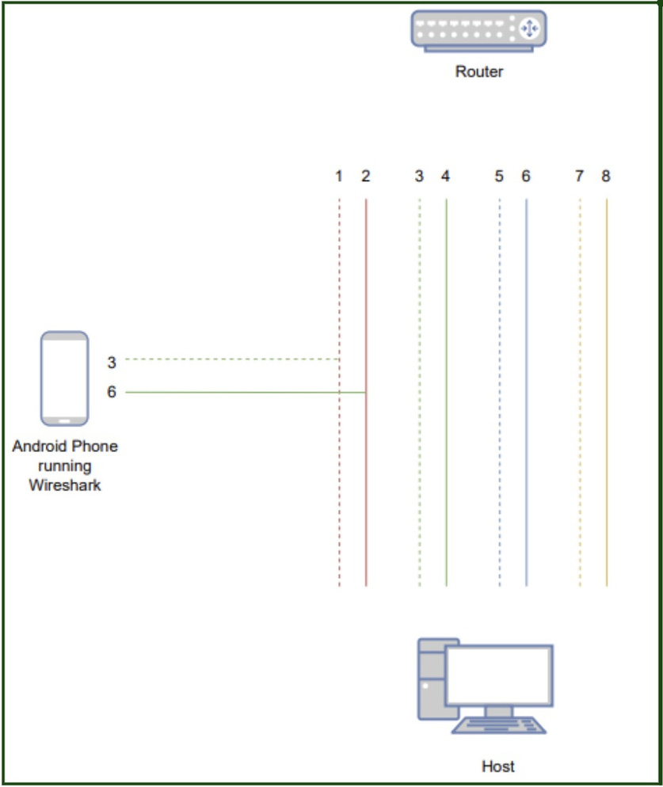
Goals
1) Create an Ethernet Wiretap Device that captures data that flow between devices.
2) The wiretap must be compact, unobtrusive and easy to conceal.
3) The wiretap must be undetected by network security devices like Network Access Control (NAC).
4) Generate a .pcap file to be later accessed by C2
server.

Slide 6
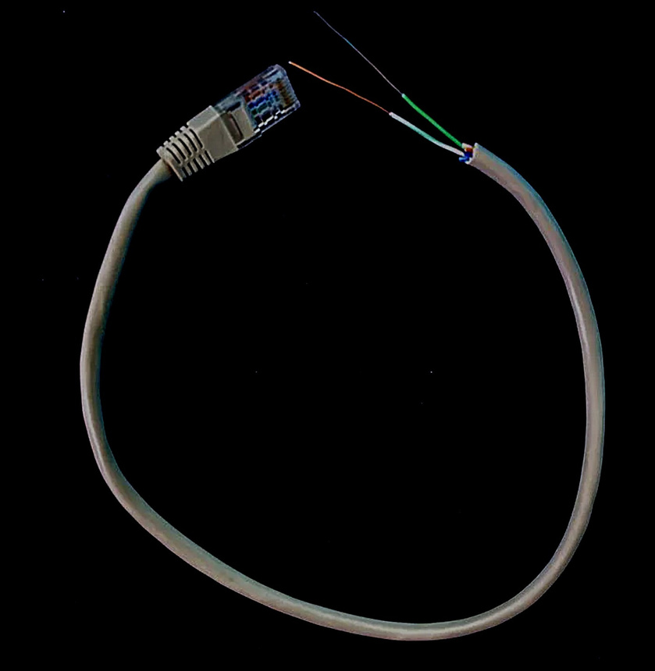
Project Requirements
Hardware:
4 X RJ45 Cat- Ethernet Patch/Lan Cable
Any Nexus, OnePlus or Samsung phone running Android 10 or above
RJ45 to type C connector
Software:
Termux
Kali Nethunter
Wireshark
Nethunter Kex

Slide 7
PROCEDURE

Slide 8
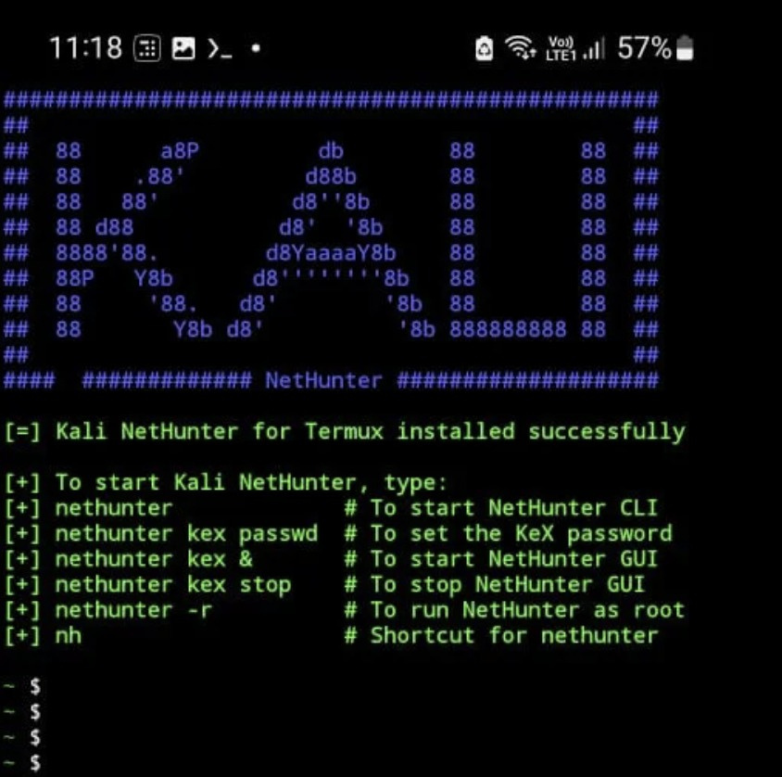
Step 1 | Download Termux from play store.
Step 2 | Update Repositories using command “apt update”.
Step 3 | Install wget using command “apt install wget”.
Step 4 | Download Kali Nethunter using command “wget -O install-nethunter-termux https://offs.ec/2MceZWr”.
Step 5 | Run Kali Nethunter install script.
Step 6 | Setup Nethunter kex.
Step 7 | Access Kali Linux GUI using Nethunter Kex.
STEPS FOR SETTING UP
KALI NETHUNTER

Slide 9
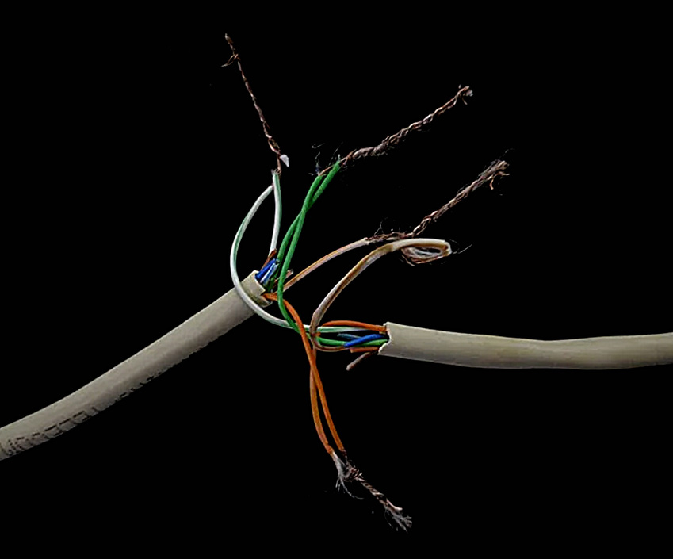
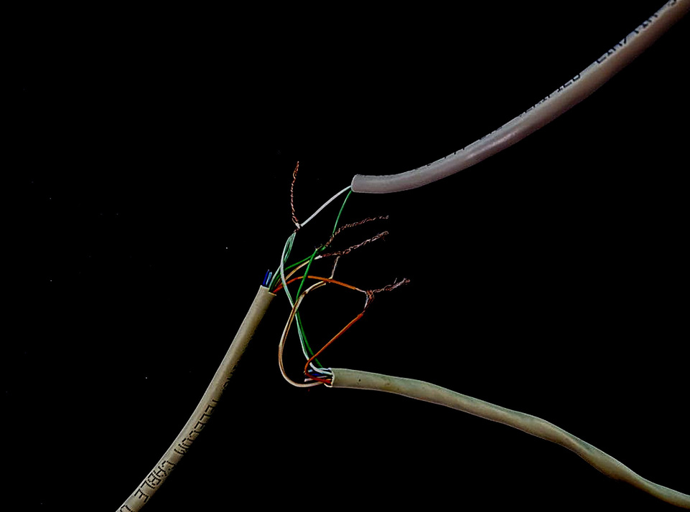
Step 1 | Splicing and connecting two RJ45 cables to facilitate data transmission between a host and router.
Step 2 | Connect the tap wire, which is linked to an Android phone running Kali Nethunter, to the wire carrying data from the router to the host.
STEPS FOR CREATING TAP USING RJ45 CABLES

Slide 10

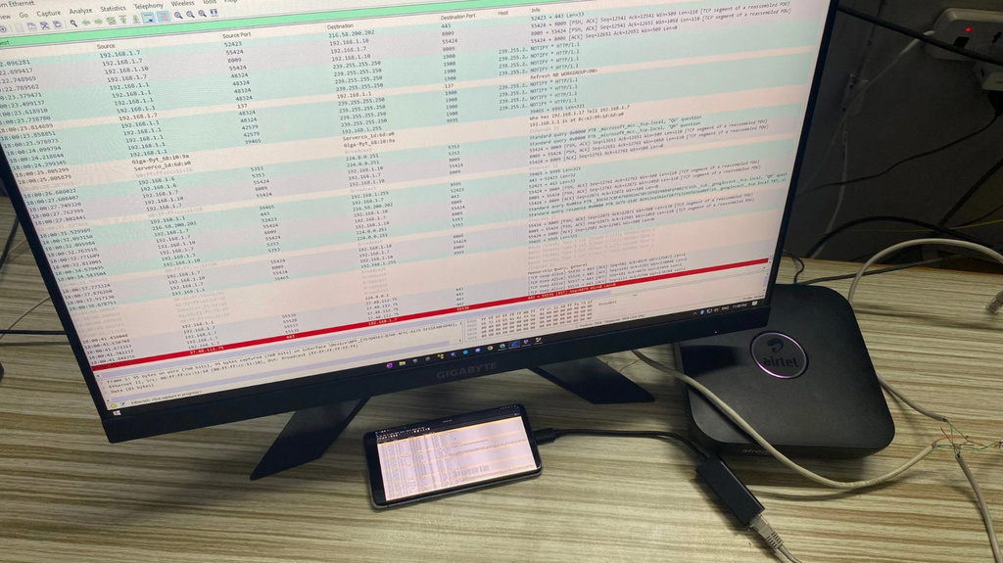
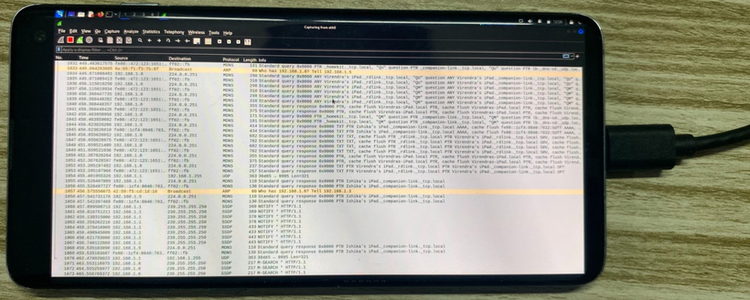

Step 1 | Connect the phone to wiretap by a Type-C to Ethernet dongle.
Step 2 | Open Wireshark and start capturing.
STARTING THE CAPTURE

Slide 11
CONCLUSION
FURTHER SCOPE
In conclusion, the Ethernet Wiretap was successful in the objective of discreetly intercepting data packets within the network while remaining undetected by security measures like Network Access Control (NAC).
By addressing the challenges of compactness and discretion, the wiretap ensures undetected integration into the network infrastructure without raising any suspicion.
The functionality of the wiretap can be extended with a capture interruption script. Halt ongoing capture, generate pcap file of data captured, and forward it to a command center.
Additionally, we can use compact devices, such as Raspberry Pi, which enhances concealment compared to larger alternatives like Android phones.

